Slide 1

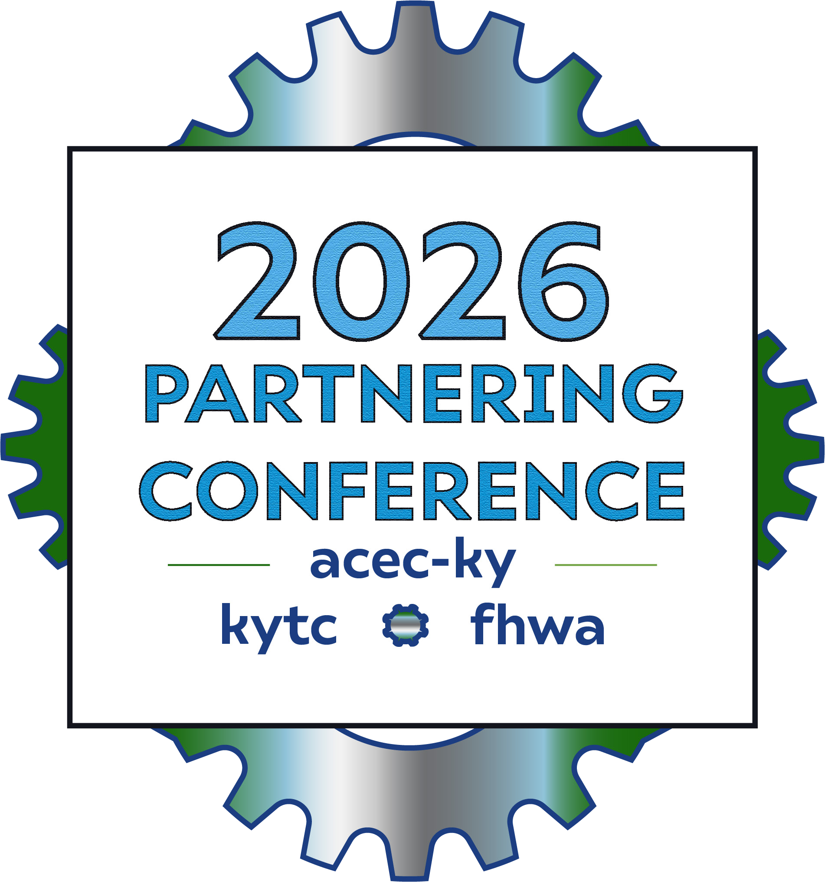
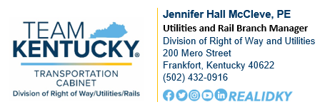
Utility Dispute Resolution for Transportation Projects

Slide 2

What is Utility Conflict Management?
Utility Management Complications
Disputes
Resolution Process
Next steps

Slide 3


What is Utility Conflict Management?
Utility Conflict Management
Complex and iterative
Significantly impacts transportation projects
Identify and resolve conflicts with existing utility infrastructure
Five stages
Utility Investigation
Utility Conflict Identification
Utility Coordination
Utility Construction Management
Utility Design

Slide 4
Utility Management Complications
FEDERAL REVIEW
UM Complications
Unsuccessful Collaboration
Disputes
FHWA Observation
KYTC has no formal dispute resolution process
Recommendation
Develop and implement a formal process
It would address and mitigate conflicts during coordination, relocation, or agreement execution.
Clearly defined steps, such as escalation procedures, timelines for resolution, and mediation or arbitration.
Improve communication, reduce delays, and foster stronger relationships

Slide 5

KYTC’s Relationship with Utilities
KYTC and utility companies must cooperatively work together to address conflicts the KYTC project imparts on existing utilities.
Disputed solutions can and will happen.
Unaddressed disputes negatively impact the project.

Slide 6
Negative Impacts of Disputes
Utility relocation schedule delays
Cabinet project construction delays
Increased costs
Poor relationships
Future project complications

Slide 7
Dispute Types
Contracts
Design
Estimates
Schedules
Reimbursements
Construction

Slide 8
Contracts
Language
Scope
Change order

Slide 9
Utility relocation design elements
Utility relocation plan
Cabinet project plan
Design

Slide 10
Estimates
Utility cost
Betterment calculations
Cost sharing precentages

Slide 11
Schedules
Utility design delays
Utility construction delays
Cabinet project delays

Slide 12
Reimbursements
Invoice documentation
Eligibility
Field validation

Slide 13
Construction
Accommodation standards
Field changes
BABA compliance
Unknown utilities
Abandoned utilities

Slide 14
Resolution Process
Identify Dispute
Negotiate in District
Escalate to Central Office
Elevate to Utility Council
Appeal to KYTC Leadership

Slide 15
Identify Dispute
District Utility Expert & Utility Company
Negotiate in District Office
District Utility Expert & Utility Company
Escalate to Central Office
District Utility Expert, Utility Company & Regional Utility Expert
Elevate to Utility Council
District Utility Expert, Utility Company, Regional Utility Expert & Statewide Utility Council
Appeal to KYTC Leadership
State Highway Engineers Office, Division Director, & Legal Office

Slide 16
Identify Dispute
Discovered by the district office utility section (DO) and utility company
Informal in nature
Dispute notices recorded in KURTS
No specific duration
Either party may trigger a negotiation

Slide 17
Negotiate in District Office
Adds Utility supervisor (US)
Set a deadline
Recorded in KURTS
If no resolution by the deadline notify the other party
Provide 1 week to respond
Complete a Dispute Decision Form to escalate

Slide 18
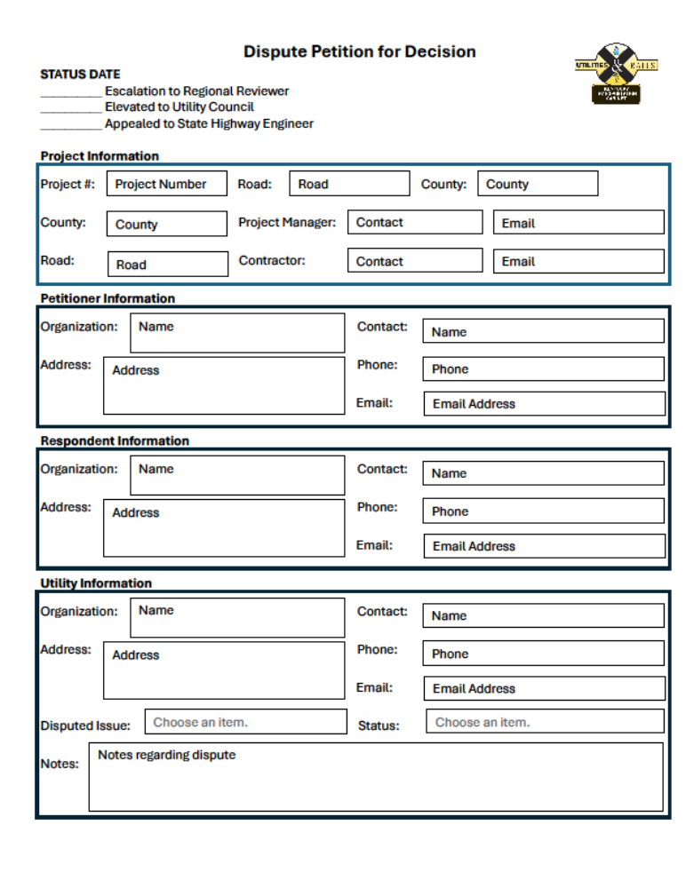
Identify Dispute
Negotiate in District
Escalate to Central Office
Elevate to Utility Council
Appeal to KYTC Leadership

Slide 19
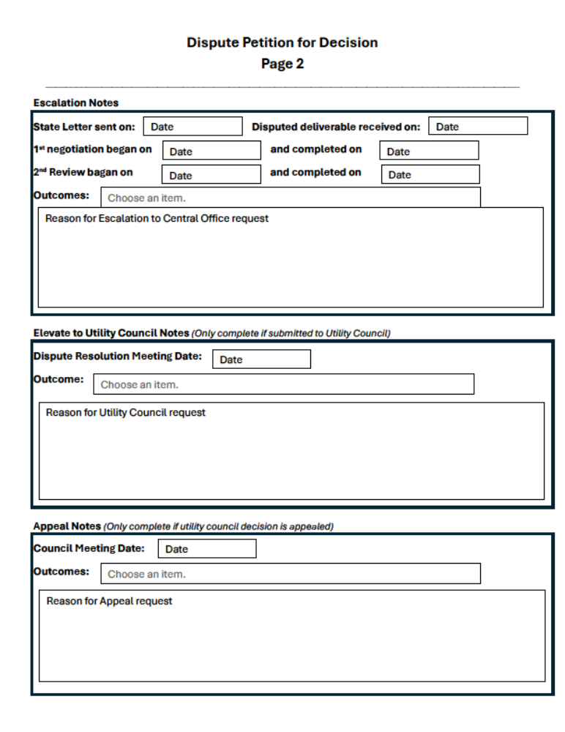
Identify Dispute
Negotiate in District
Escalate to Central Office
Elevate to Utility Council
Appeal to KYTC Leadership

Slide 20
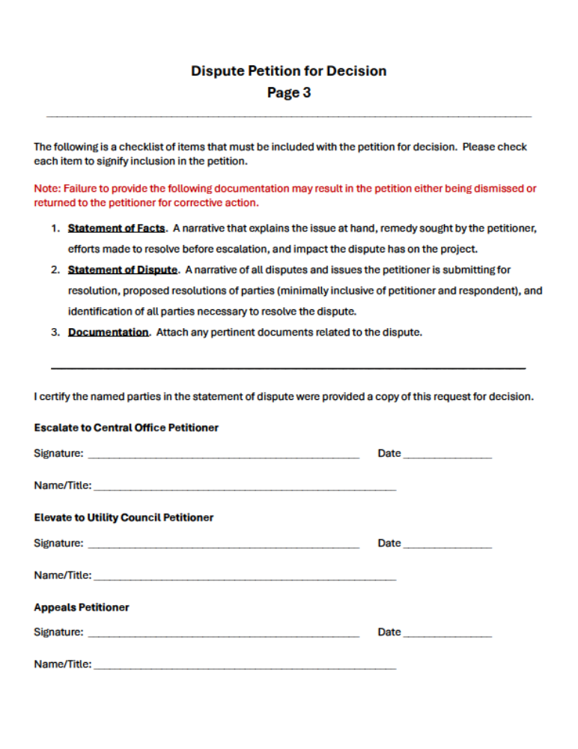
Identify Dispute
Negotiate in District
Escalate to Central Office
Elevate to Utility Council
Appeal to KYTC Leadership

Slide 21
Escalate Dispute to Central Office
Adds the regional utility coordinator (AC)
Formal meeting in 1 week
10 days to resolve
If not resolved, the dispute form is updated and sent to the utility branch manager (UBM)
Provide 1 week to respond

Slide 22
Identify Dispute
Negotiate in District
Escalate to Central Office
Elevate to Utility Council
Appeal to KYTC Leadership

Slide 23
Identify Dispute
Negotiate in District
Escalate to Central Office
Elevate to Utility Council
Appeal to KYTC Leadership

Slide 24
Identify Dispute
Negotiate in District
Escalate to Central Office
Elevate to Utility Council
Appeal to KYTC Leadership

Slide 25
Utility Council Pool
Identified annually
Division of Right of Way and Utilities managed
Selected if no conflict of interest
Used when a dispute is escalated
Internal Pool Members
Utility subject matter experts
Legal
Fiscal
Design
Construction
Policy
External Pool Members
Water Utility
Sewer Utility
Electric Utility
Communications Utility
Gas Utility

Slide 26
Statewide Utility Council
One (1) Cabinet utility expert
One (1) Cabinet specialty expert
Two (2) Utility company representatives
One (1) Division of Right of Way and Utilities representative

Slide 27
Elevate to Utility Council
Statewide utility council is organized in 1 week
Council Decision Meeting is held within 15 days
Render a decision in 1 week
1 week to appeal with updated dispute form

Slide 28
Identify Dispute
Negotiate in District
Escalate to Central Office
Elevate to Utility Council
Appeal to KYTC Leadership

Slide 29
Identify Dispute
Negotiate in District
Escalate to Central Office
Elevate to Utility Council
Appeal to KYTC Leadership

Slide 30
Identify Dispute
Negotiate in District
Escalate to Central Office
Elevate to Utility Council
Appeal to KYTC Leadership

Slide 31
Appeal to KYTC Leadership
Adds Cabinet leadership: State Highway Engineer’s Office (SHE), Right of Way and Utilities Division Director (ROWD), and the Office of Legal Services (OLS)
No specific duration

Slide 32
Next steps
Policy adoption
Monitor execution
1-year review
Available Late 2026
Build Utility Dispute Council
Questions?

